Slide 1
LAB 6 TA 陳昱丞
yucheng.cs11@nycu.edu.tw

Slide 2
Deadline: 2023/5/30(Tue) 12:00 No Demo

Slide 3
Must use sample code, otherwise no credit.
In this lab,

Slide 4
Outline
Part 1: High-Level Observation
Solve LunarLander-v2 using DQN (30%)
Solve LunarLanderContinuous-v2 using DDPG (30%)
Bonus: Implement DDQN (5%)
Bonus: Implement TD3 (10%)
Part 2: Low-Level Observation
Solve BreakoutNoFrameskip-v4 using DQN (40%)
Report:
Result (0% but necessary)
Bonus: Questions (10%)

Slide 5
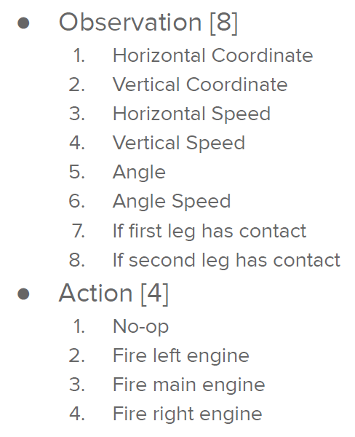
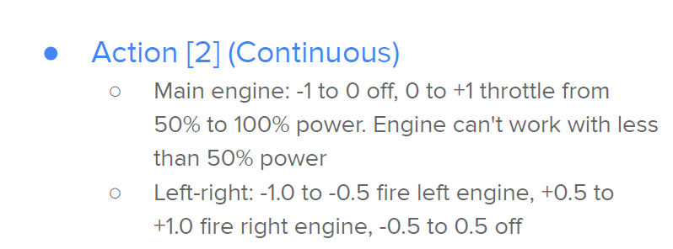
LunarLander-v2

Slide 6
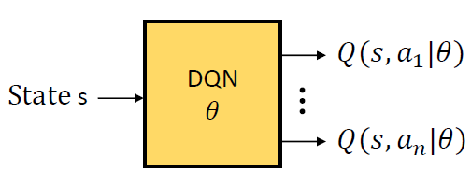
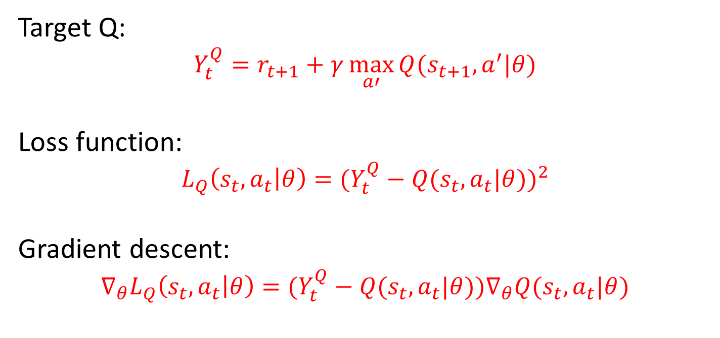
Deep Q-Network (DQN)
Target Q:
$$Y_{t}^{Q}=r_{t+1}+γ\max_{a′}{Q(s_{t+1},a^{′}|θ)}$$
Loss function:
$$L_{Q}\left(s_{t},a_{t} | θ\right)={(Y_{t}^{Q}−Q(s_{t},a_{t}|θ))}^{2}$$
Gradient descent:
$$∇_{θ}L_{Q}\left(s_{t},a_{t} | θ\right)=(Y_{t}^{Q}−Q(s_{t},a_{t}|θ))∇_{θ}Q(s_{t},a_{t}|θ)$$

Slide 7
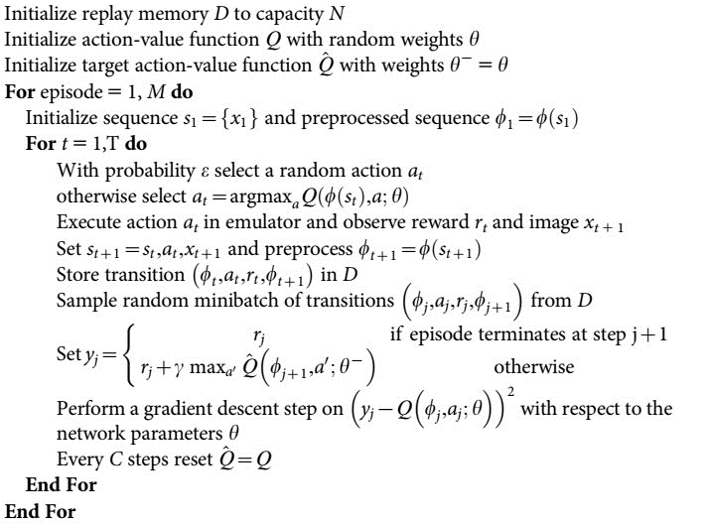
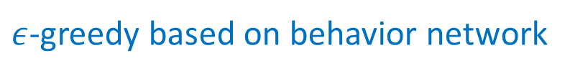
Deep Q-Network (DQN)
Algorithm 1 – Deep Q-learning with experience replay:
Behavior and target network
$ε$-greedy based on behavior network
Experience replay
Update behavior and target network

Slide 8
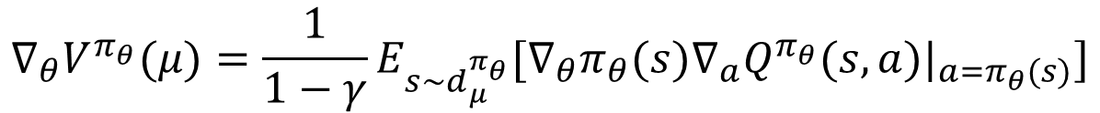
Deep Deterministic Policy Gradient (DDPG)
Consider continuous actions and deterministic policy: $a=π_{θ}(s)$
Deterministic Policy Gradient Theorem:
$$∇_{θ}V^{π_{θ}}(μ)=\frac{1}{1−γ}E_{s\sim d_{μ}^{π_{θ}}}[∇_{θ}π_{θ}(s)∇_{a}Q^{π_{θ}}(s,a)|_{a=π_{θ}(s)}]$$
Off-policy Deterministic Policy Gradient:
$$∇_{θ}J_{β}^{π_{θ}}≈E_{s\sim d_{μ}^{β}}[∇_{θ}π_{θ}(s)∇_{a}Q^{π_{θ}}(s,a)|_{a=π_{θ}(s)}]$$

Slide 9



Deep Deterministic Policy Gradient (DDPG)
$$∇_{θ}J_{β}^{π_{θ}}≈E_{s\sim d_{μ}^{β}}[∇_{θ}π_{θ}(s)∇_{a}Q^{π_{θ}}(s,a)|_{a=π_{θ}(s)}]$$
$$Q^{π_{θ}}(s,a)$$
gradient ascent
$$a$$
$$a=π_{θ}(s)$$

Slide 10
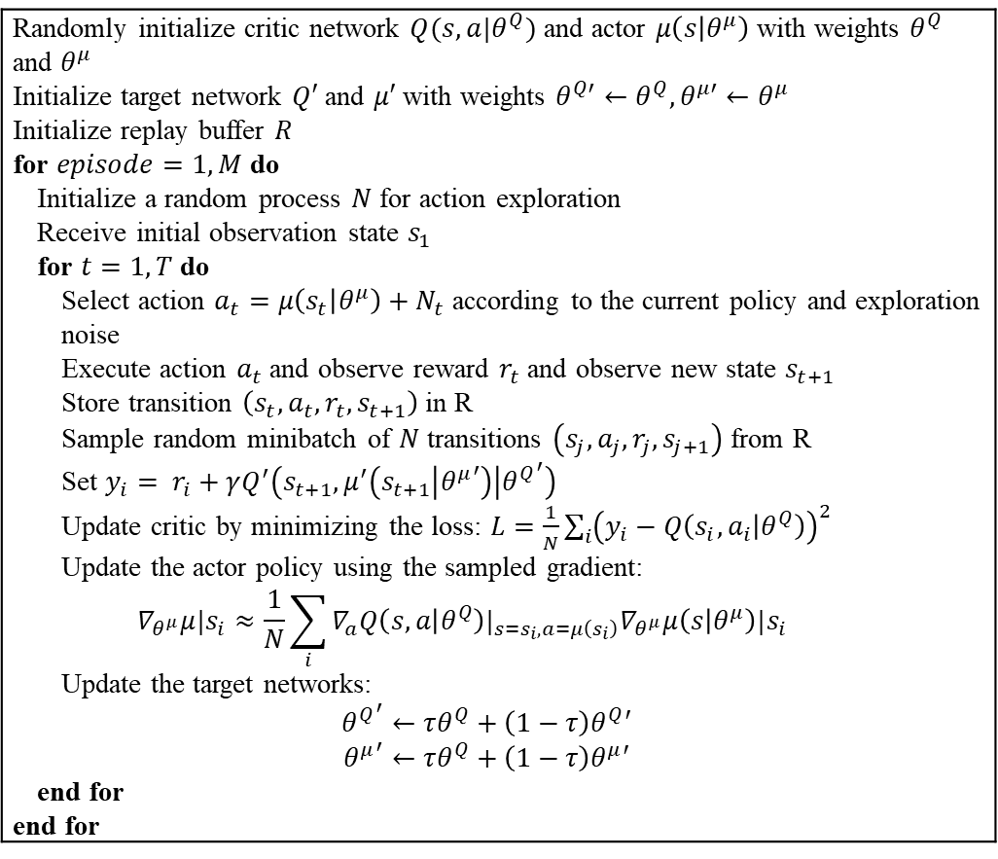
Deep Deterministic Policy Gradient (DDPG)
Algorithm 1 – DDPG:
Randomly initialize critic network $Q(s,a|θ^{Q})$ and actor $μ\left(s | θ^{μ}\right)$ with weights $θ^{Q}$ and $θ^{μ}$ Initialize target network $Q′$ and $μ′$ with weights $θ^{Q′}←θ^{Q}, θ^{μ′}←θ^{μ}$ Initialize replay buffer $R$ for $episode=1,M$ do Initialize a random process $N$ for action exploration Receive initial observation state $s_{1}$ for $t=1,T$ do Select action $a_{t}=μ\left(s_{t} | θ^{μ}\right)+N_{t}$ according to the current policy and exploration noise Execute action $a_{t}$ and observe reward $r_{t}$ and observe new state $s_{t+1}$ Store transition $\left(s_{t},a_{t}, r_{t},s_{t+1}\right)$ in R Sample random minibatch of $N$ transitions $\left(s_{j},a_{j}, r_{j},s_{j+1}\right)$ from R Set $y_{i}= r_{i}+γQ^{′}\left(s_{t+1},μ^{′}\left(s_{t+1} | {θ^{μ}}^{′}\right) | {θ^{Q}}^{′}\right)$ Update critic by minimizing the loss: $L=\frac{1}{N}\sum_{i}{{\left(y_{i}−Q\left(s_{i},a_{i} | θ^{Q}\right)\right)}^{2}}$ Update the actor policy using the sampled gradient: $$∇_{θ^{μ}}μ|s_{i}≈\frac{1}{N}\sum_{i}{∇_{a}Q\left(s,a | θ^{Q}\right)|_{s=s_{i},a=μ\left(s_{i}\right)}∇_{θ^{μ}}μ\left(s | θ^{μ}\right)|s_{i}}$$ Update the target networks: $${θ^{Q}}^{′}←τθ^{Q}+\left(1−τ\right)θ^{Q}′$$ $${θ^{μ}}^{′}←τθ^{Q}+\left(1−τ\right)θ^{μ}′$$ end for end for
2 Behavior and 2 target networks
Action drawn from deterministic policy with exploration
Experience replay
Update actor and critic
Update target networks (soft update)

Slide 11
TODO
Solve LunarLander-v2 using DQN.
Solve LunarLanderContinuous-v2 using DDPG.
Find the #TODO comments and hints, remove the raise NotImplementedError.
Screenshot your tensorboard and testing results and put it on the report.

Slide 12
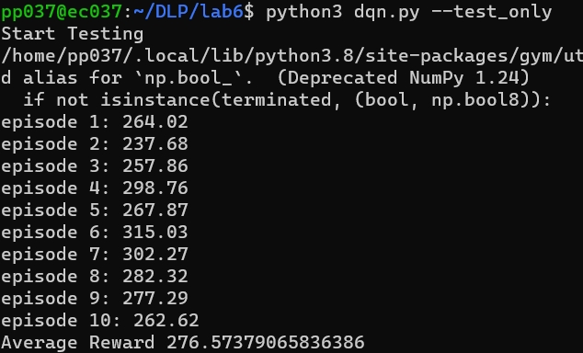
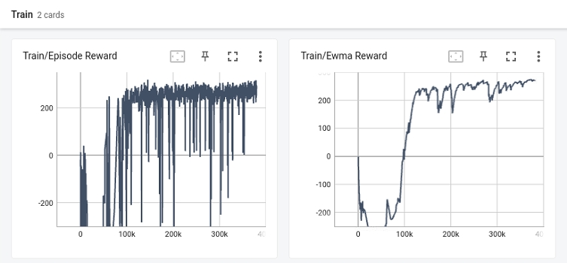
TODO
Screenshot your tensorboard and testing results and put it on the report.

Slide 13
Scoring Criteria
DQN performance (30%)
Bonus: implement DDQN (5%)
DDPG performance (30%)
Bonus: implement TD3 (10%)
Run test 10 times, average score:
average score | points
<= 0 | 0
0 ~ 100 | 5
100 ~ 150 | 10
150 ~ 200 | 20
>= 200 | 30

Slide 14
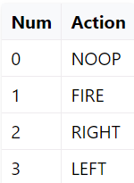
BreakoutNoFrameskip-v4
Observation space:
The whole image
Action space:

Slide 15
TODO
Solve BreakoutNoFrameskip-v4 using DQN.
You can use any trick you want.
Screenshot your tensorboard and testing results and put it on the report.

Slide 16
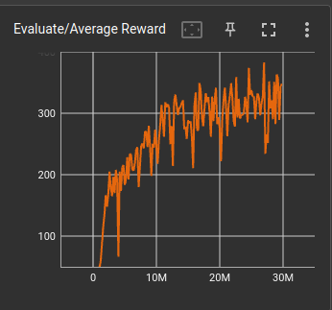
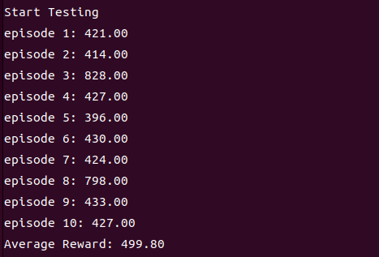
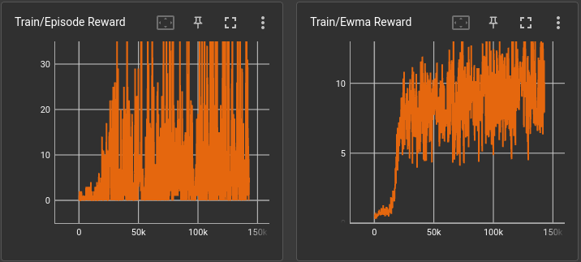
TODO
Screenshot your tensorboard and testing results and put it on the report.

Slide 17
Hint: Trick 1
Use make_Atari() and wrap_deepmind() provided by OpenAI baselines.
atari_wrappers.py
Remember to set episode_life=False, clip_rewards=False while testing.

Slide 18
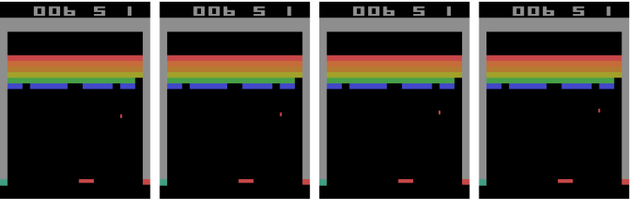
Hint: Trick 2
Stack a sequence of four frames together.
state
frame 1: frame 2: frame 3: frame 4:

Slide 19
Scoring Criteria
Performance (40%)
Run test 10 times, min(5 * sqrt(average score), 100).
For example:
sqrt(499.8) = 22.35
5 * 22.35 = 111.75
min(111.75, 100) = 100
40 * 100% = 40 points you get

Slide 20
Tensorboard Remote Server
ssh -p 10043 -L 6006:localhost:6006 pp037@140.113.215.196
tensorboard --logdir log/dqn
或
ssh -p 11322 -L 8008:localhost:8008 lin@140.113.13.97
tensorboard --logdir log/dqn --port=8008
Open your browser locally and input 127.0.0.1:6006

Slide 21
Package Version
gym 0.15.7
numpy 1.22.3
pytorch 1.7.1
tensorboard 2.10.0

Slide 22
Reminders
Your network architecture and hyper-parameters can differ from the defaults.
Ensure the shape of tensors all the time especially when calculating the loss.
with no_grad() : scope is the same as xxx.detach()
Be aware of the indentation of hints.
When testing DDPG, action selection need NOT include the noise.

Slide 23
References
Mnih, Volodymyr et al. “Playing Atari with Deep Reinforcement Learning.” ArXiv abs/1312.5602 (2013).
Mnih, Volodymyr et al. “Human-level control through deep reinforcement learning.” Nature 518 (2015):529-533.
Van Hasselt, Hado, Arthur Guez, and David Silver. “Deep Reinforcement Learning with DoubleQ-Learning.” AAAI. 2016.
Lillicrap, Timothy P. et al. “Continuous control with deep reinforcement learning.” CoRRabs/1509.02971 (2015).
Silver, David et al. “Deterministic Policy Gradient Algorithms.” ICML (2014).
OpenAI. “OpenAI Gym Documentation.” Retrieved from Getting Started with Gym: https://gym.openai.com/docs/ .
OpenAI. “OpenAI Wiki for Pendulum v0.” Retrieved from Github: https://github.com/openai/gym/wiki/Pendulum-v0 .
PyTorch. “Reinforcement Learning (DQN) Tutorial.” Retrieved from PyTorch Tutorials: https://pytorch.org/tutorials/intermediate/reinforcement_q_learning.html .

